Slide 1
CHAPTER-3 ROUTING

Slide 2
what is Routing?
Routing is the method by which network devices direct messages across networks to arrive at the correct destination.
All routers must make routing decisions by looking routing table.
These routing tables also contain information about the routes, or paths, that the router uses to reach other remote networks that are not locally attached.
These routes can be statically assigned to the router by an administrator, or they can be dynamically given to the router by another router via a program called a routing protocol.

Slide 3
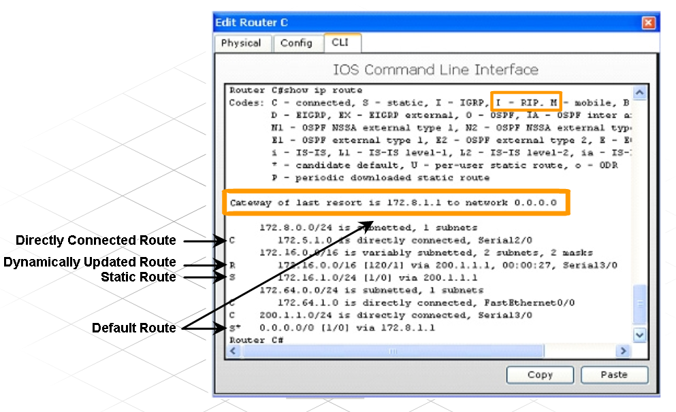
Cont…
To direct a message to the correct destination, the router looks at the destination IP address in the packet and then looks for a matching route in the routing table.

Slide 4
Directly-Connected Routes
When the router powers up, the configured interfaces are enabled.
As they become operational, the router stores the directly attached local network addresses as connected routes in the routing table.
These routes are automatically updated whenever the interface is reconfigured or shutdown.

Slide 5
Types of Routes
Static Routes
Default Routs
Dynamic Routes
RIP,IGRP,EIGRP,OSPF,IS-IS , BGP

Slide 6
1. Static Routes
A network administrate can manually configure a static route to a specific network.
A static route does not change until the administrator manually reconfigures it.
These routes are identified in the routing table with the prefix S.

Slide 7
Steps to configure static route
1. Connect to the router using a console cable.
2. Open a HyperTerminal window to connect with router .
3. Enter privileged mode, by typing enable at the Router1>
Note how the > symbol changes to a # to indicate that privilege mode is operative.
Router1>enable
Router1#
4. Enter global configuration mode.
Router1#config terminal
Router1(config)#
5. Use the ip route IOS command to configure the static route, with the following format:
ip route [destination_network] [subnet_mask] [gateway_address]
Router1(config) #ip route 192.168.16.0 255.255.255.0 192.168.15.1

Slide 8
Cont…
To enable two-way communication with a host on network 192.168.16.0, the administrator also configures a static route on Router 2.
Since static routes are configured manually, network administrators must add and delete static routes to reflect any changes in network topology.
On small networks with few possible changes, static routes require very little maintenance.
In a large network, the manual maintenance of routing tables could require significant administrative time

Slide 9
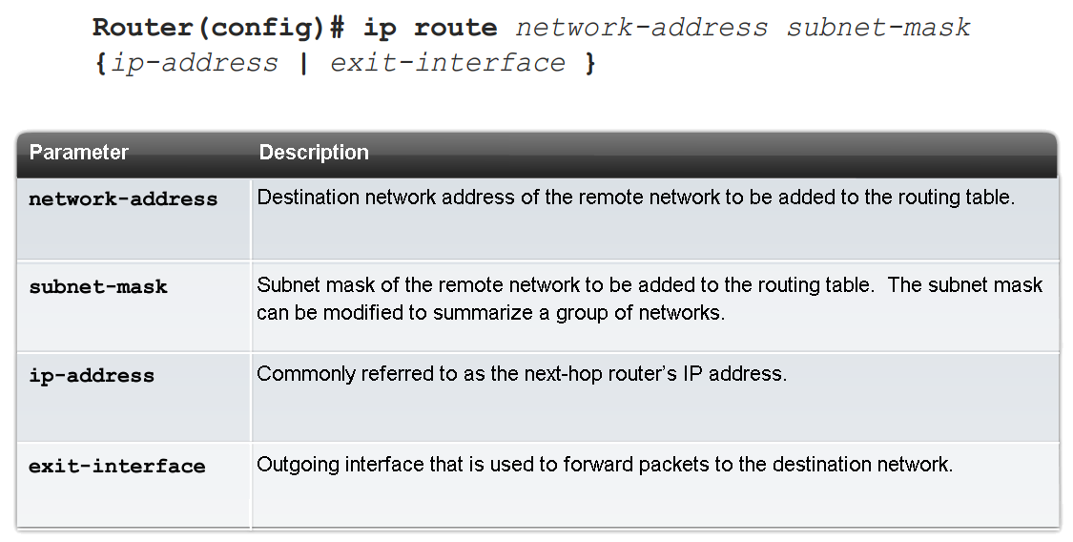
Cont…
.

Slide 10
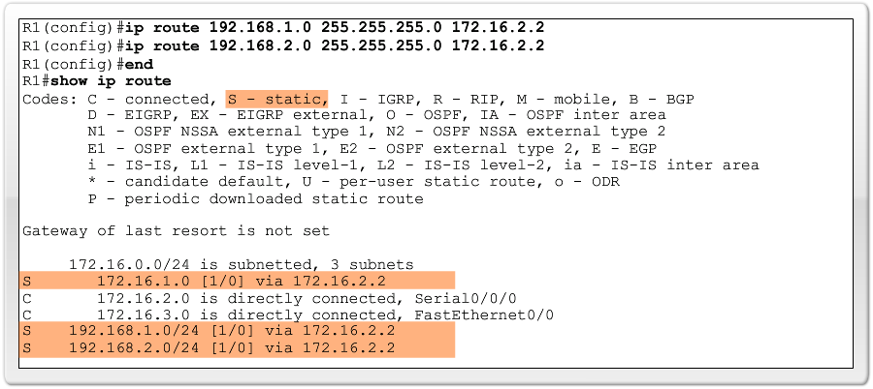
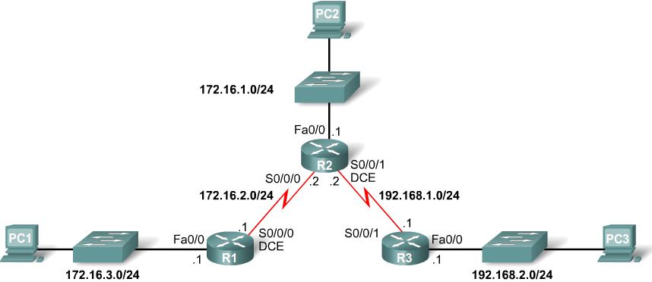
Cont…
Configuring routes to 2 or more remote networks
R1(config)# ip route 192.168.1.0 255.255.255.0 172.16.2.2
R1(config)# ip route 192.168.2.0 255.255.255.0 172.16.2.2

Slide 11
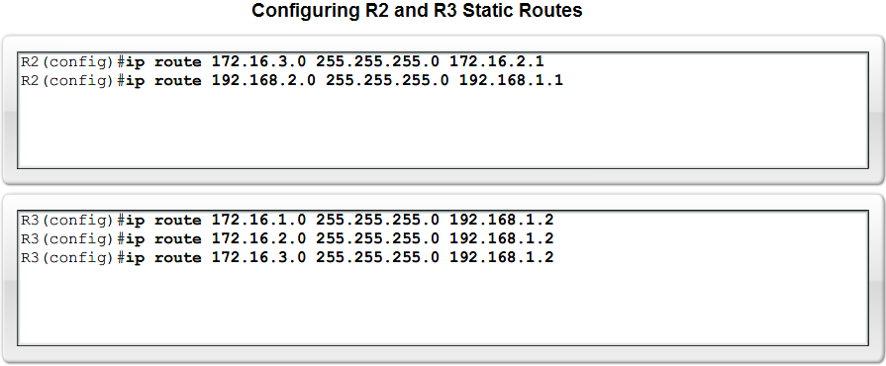
Cont…

Slide 12
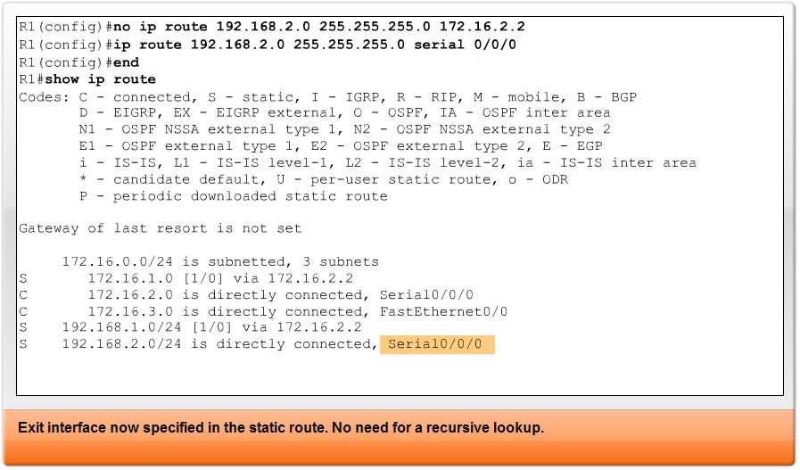
Static rout using exit interface
Configuring a Static route with an Exit Interface
single search instead of 2 searches.

Slide 13
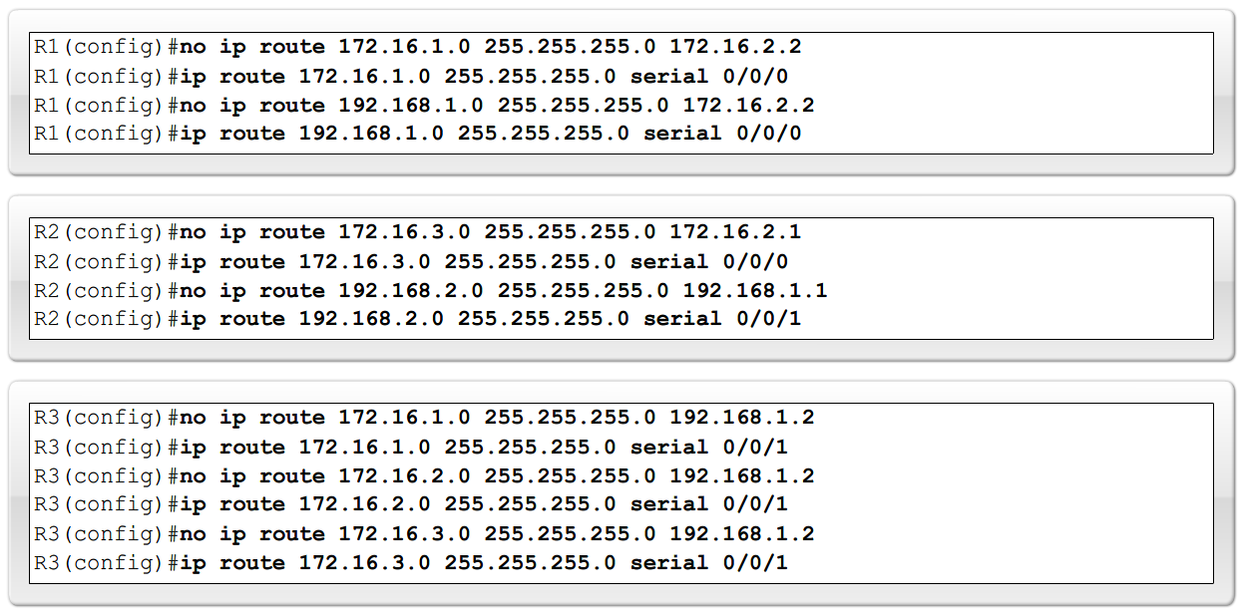
Cont…
Modifying Static routes
Existing static routes cannot be modified. The old static route must be deleted by placing no in front of the ip route
Example:
no ip route 192.168.2.0 255.255.255.0 172.16.2.2
A new static route must be rewritten in the configuration

Slide 14
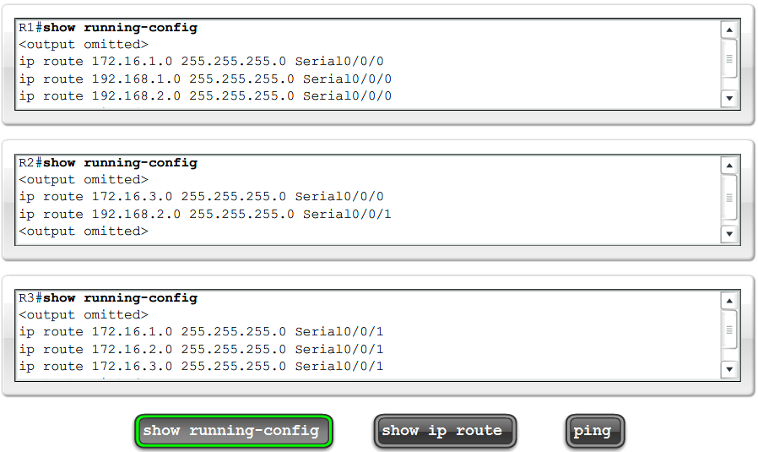
Verifying the Static Route Configuration

Slide 15
2. Default-Rout
The default route is a type of static route which specifies a gateway to use when the routing table does not contain a path to use to reach the destination network.
It is common for default routes to point to the next router in the path to the Internet Service Provider.
It use default network 0.0.0.0 and subnet 0.0.0.0
These routes are identified in the routing table with the prefix S*.

Slide 16
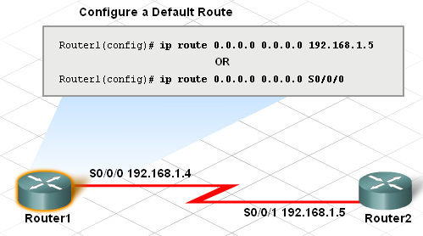
Cont…
Router(config)#ip route 0.0.0.0 0.0.0.0 <Next Hop IP Address>
or
Router(config)#ip route 0.0.0.0 0.0.0.0 <interface> <port number>

Slide 17
3. Dynamic routing
Routers need a way to quickly update routes that does not depend on the administrator.
Dynamic routing adjust their routing tables accordingly, without the intervention of the network administrator.
A dynamic routing learns all available routes, places the best routes into the routing table, and removes routes when they are no longer valid.

Slide 18
Cont…
Routing protocol uses routing algorithm to determine the best route to a destination network.
There are two main classes of routing algorithms:
Distance vector
Link state
Each type uses a different method for determining the best route to a destination network.

Slide 19
Distance vector
Type of standards that uses distance to select the best path, e,g RrIP, IGRP,EIGRP
Routers running distance vector routing protocols share network information with directly connected neighbors.
The neighbor routers then advertise the information to their neighbors, until all routers in the enterprise learn the information.
A router running a distance vector protocol does not know the entire path to a destination. it only knows the distance to the remote network and the direction, or vector, Its knowledge comes through information from directly connected neighbors.
distance vector protocols use a metric to determine the best route.

Slide 20
Cont…
Metric:- is information stored on routing table uses to determine the best route on a network.
Metric include bandwidth, delay, hop count, MTU, and reliability
Hope count:- Routing metric that tracks the number of legs that a data packets traverses b/n a source and destination,
Hop:- transfer of packet b/n two network devices, such as router
MTU(maximum transmission unit):-maximum packet size, by bytes, that a particular interface can handle.
Delay:- Length of time required to move a packet from source to destination.
RIP versions 1 and 2 are true distance vector protocols, where as EIGRP is actually a distance vector protocol with advanced capabilities

Slide 21
Link-state
Enterprise networks and ISPs use link-state protocols because of their hierarchical design and ability to scale for large networks.
Distance vector routing protocols are usually not the right choice for a complex enterprise network.
Link-state routing protocols, such as OSPF, do not send frequent periodic updates of the entire routing table.
Instead, after the network converges, a link-state protocol sends an update only when a change in the topology occurs, such as a link going down.
Routers running RIP receive updates from their immediate neighbors, but with no details about the network as a whole.

Slide 22
Cont…
Routers running OSPF generate a complete map of the network from their own viewpoint.
This map allows them to quickly determine loop-free alternate paths in the case of a network link failure.
Compared with distance vector protocols, link-state routing protocols:
Requires more complex network planning and configuration
Requires increased router resources
Requires more memory for storing multiple tables
Requires more CPU and processing power for the complex routing calculations

Slide 23
Cont…
Link-state routing, in contrast, requires that all routers know about the paths reachable by all other routers in the network.
Link-state information is flooded throughout the link-state domain (an area in OSPF or IS-IS) to ensure all routers posses a synchronized copy of the area's link-state database
(picture Mod2, 6.1.1.1)

Slide 24
RIP
Routing Information Protocol (RIP) is a distance vector routing protocol that is used in thousands of networks throughout the world.
The key characteristics of RIP include the following:
Is a distance vector routing protocol
Uses hop count as the metric for path selection
Defines a hop count greater than 15 as an unreachable route
Sends routing table contents every 30 seconds, by default
RIPv1 use only clasfull routing (which means all device should use the same NW or default subnet mask)
RIPv2 send subnet mask information with routing update

Slide 25
Cont…
The RIP protocol is simple, easy to implement, and is available free of cost with most routers.
These advantages make RIP a widely used and popular routing protocol.
However, RIP has several disadvantages:
Allows a maximum of 15 hops, so it can only be used for networks that connect no more than 16 routers in series.
Periodically sends complete copies of the entire routing table to directly connected neighbors.
Converges slowly on larger networks, when the network changes.

Slide 26
Cont…
There are currently two versions of RIP available. These are known as RIPv1 and RIPv2.
RIPv2 has many advantages over RIPv1 and is usually used unless the equipment cannot support RIPv2.
The most significant difference between RIP version 1 and version 2 is that RIPv2 can support classless routing, because it includes the subnet mask information in routing updates.
RIPv1 does not send subnet mask information in the updates; therefore it must rely on the classfull default subnet masks.

Slide 27
RIPv1
RIP Characteristics
-A classful, Distance Vector (DV) routing protocol
-Metric = hop count
-Routes with a hop count > 15 are unreachable
-Updates are broadcast every 30 seconds
RIP Operation
RIP uses 2 message types:
1. Request message:-This is sent out on startup by each RIP enabled interface
-Requests all RIP enabled neighbors to send routing table
2. Response message:-Message sent to requesting router containing routing table

Slide 28
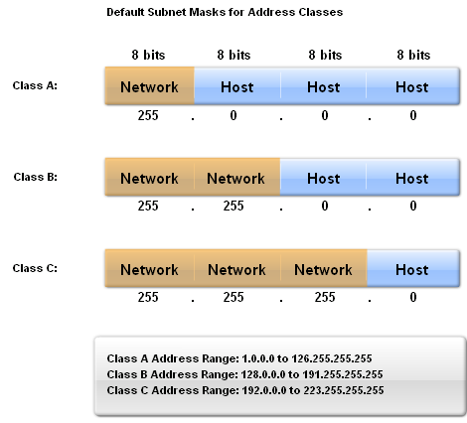
Cont…
RIPv1 is a classful routing protocol
-Does not send subnet masks in routing updates

Slide 29
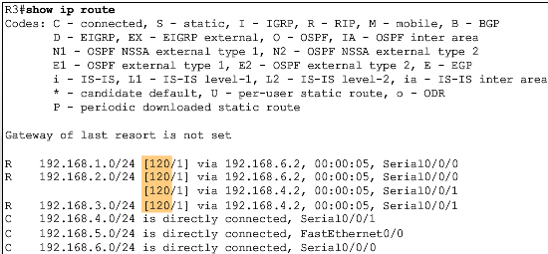
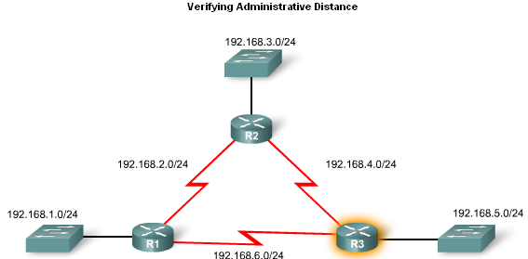
Cont…
Administrative Distance:- It’s a numeric value specifies performance of routing methods .
Router select lesser AD values
RIP AD=120 OSPF AD=110 Static rout AD=1
connected network AD=0 EIGRP AD= 90

Slide 30
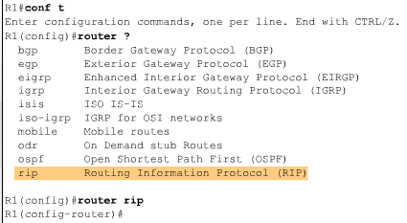
cont…
Router RIP Command
To enable RIP enter:
-Router rip at the global configuration prompt
-Prompt will look like R1(config-router)#

Slide 31
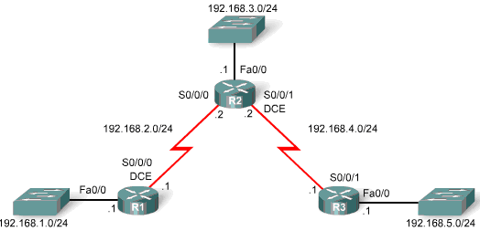
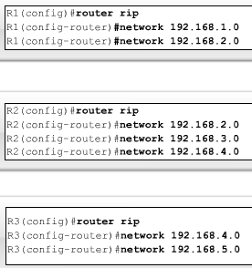
Cont…
Specifying Networks
Use the network command to:
Enable RIP on all interfaces that belong to this network
Advertise this network in RIP updates sent to other routers every 30 seconds

Slide 32
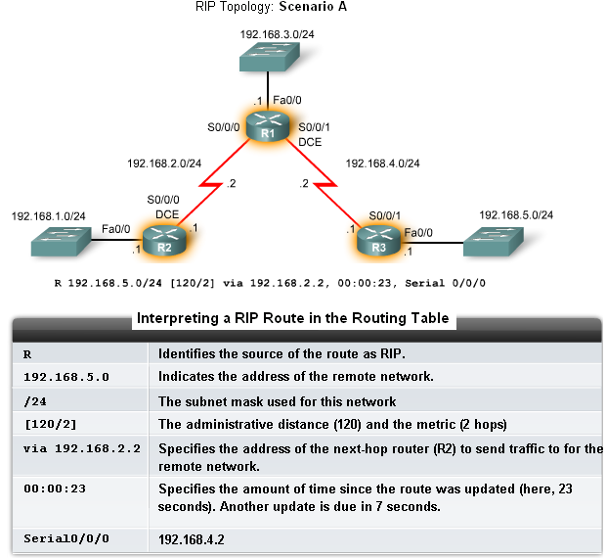
Cont…
Show ip Route
To check routing table
Router(config)#router rip
Router (config-router)#version 2
Router(config-router)#network [network-number]

Slide 33
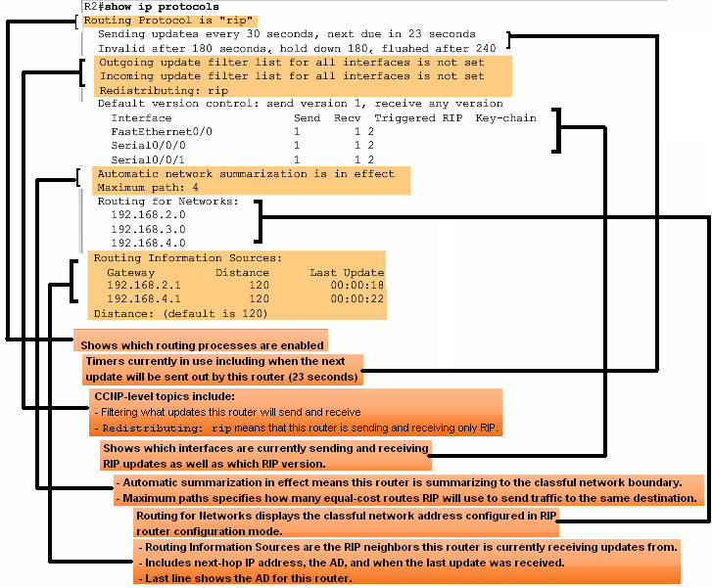
Verification and Troubleshooting
show ip protocols command
-Displays routing protocol configured on router

Slide 34
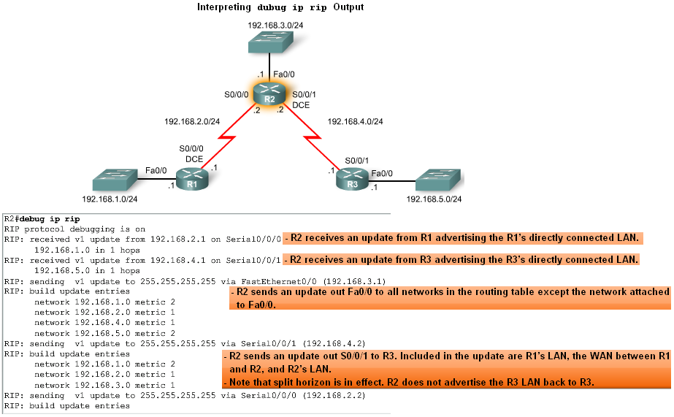
Cont…
Debug ip rip:-Used to display RIP routing updates as they are happening
Undebug all:- to stop debugs

Slide 35
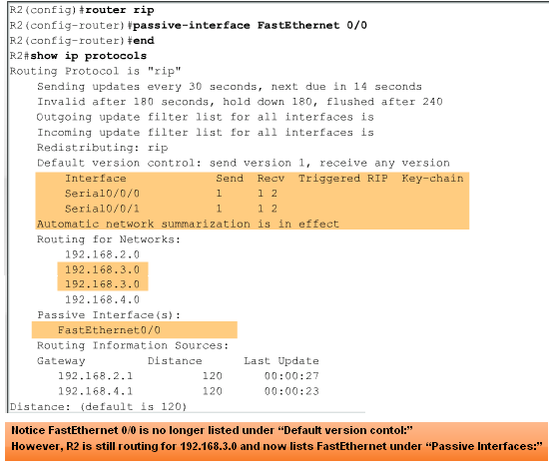
Cont…
Passive interface command
-Used to prevent a router from sending updates through an interface
Router(config-router)#passive-interface interface-type interface-number
no passive:- used to block interface
no router rip:- to remove rip routing

Slide 36
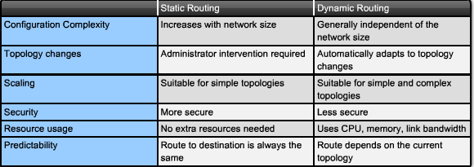
Cont…

Slide 37
Configure a DHCP
The Dynamic Host Configuration Protocol (DHCP) is a simple way to assign IP addresses to host devices.
DHCP dynamically allocates an IP address to a network host when the host is powered on
In this way, addresses can be reused when hosts no longer need them.
Steps to configuring DHCP
1. Create DHCP Address Pool
2. Specify the network and Subnet
3. Set the Default Router

Slide 38
Cont…
Router(config)#ip dhcp pool wsu-lan
Router(dhcp-config)#network 192.168.10.0 255.255.255.0
Router(dhcp-config)#default-router 192.168.10.1
Router(dhcp-config)#exit
Excluded IP address
Excluded address from the pool, so that DHCP will not assign the address to host.
Router(config)#ip dhcp excluded-address 192.168.10.20
or
Router(dhcp-config)#ip dhcp excluded-address 192.168.10.4 192.168.10.10
This address can be statically assign by administrator

Slide 39
NAT(Network Address Translation
NAT translates internal private addresses into one or more public addresses for routing onto the Internet.
Small to medium organizations connect to their ISPs through a single connection.
The local boundary router configured with NAT connects to the ISP.
NAT is used on a network to enable hosts with internal private addresses to communicate on the Internet.
When configuring NAT, at least one interface must be configured as the inside interface & another as outside interface.

Slide 40
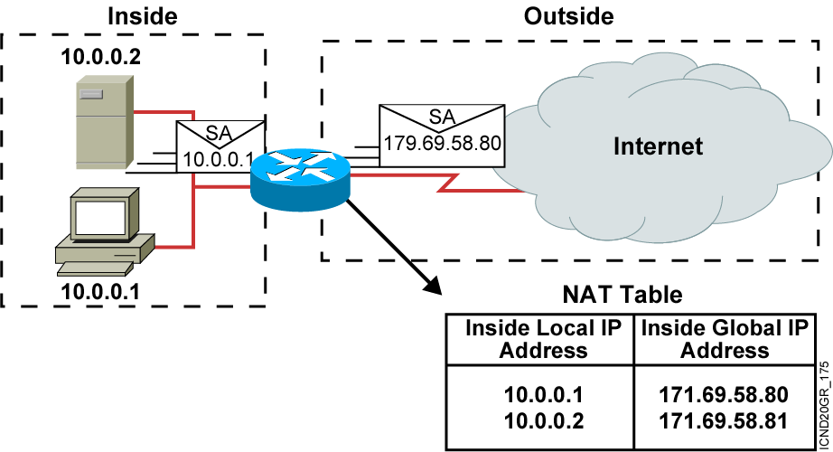
Cont…
An IP address is either local or global.
Local IP addresses are seen in the inside network.

Slide 41
Cont…
Internal private addresses translate to different public addresses each time.
Organizations use NAT to hides the actual address of hosts and servers in the enterprise.
Types of NAT
Static NAT
Dynamic NAT

Slide 42
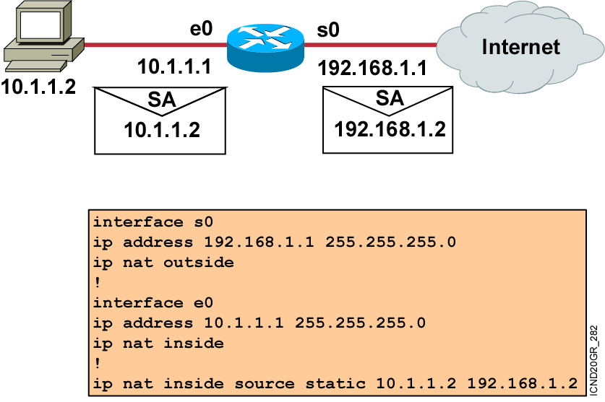
1. Static NAT
Static NAT maps a single inside local address to a single global, or public address.
This mapping ensures that a particular inside local address always associates with the same public address.

Slide 43
Dynamic NAT
Dynamic NAT uses an available pool of Internet public addresses and assigns them to inside local addresses.
Dynamic NAT assigns the first available IP address in the pool of public addresses to an inside device.
That host uses the assigned global IP address throughout the length of the session.
Once the session ends, the outside global address returns to the pool for use by another host.

Slide 44
Cont…
The address that one internal host uses to connect to another internal host is the inside local address.
The public address assigned to the organization is called the inside global address.

Slide 45
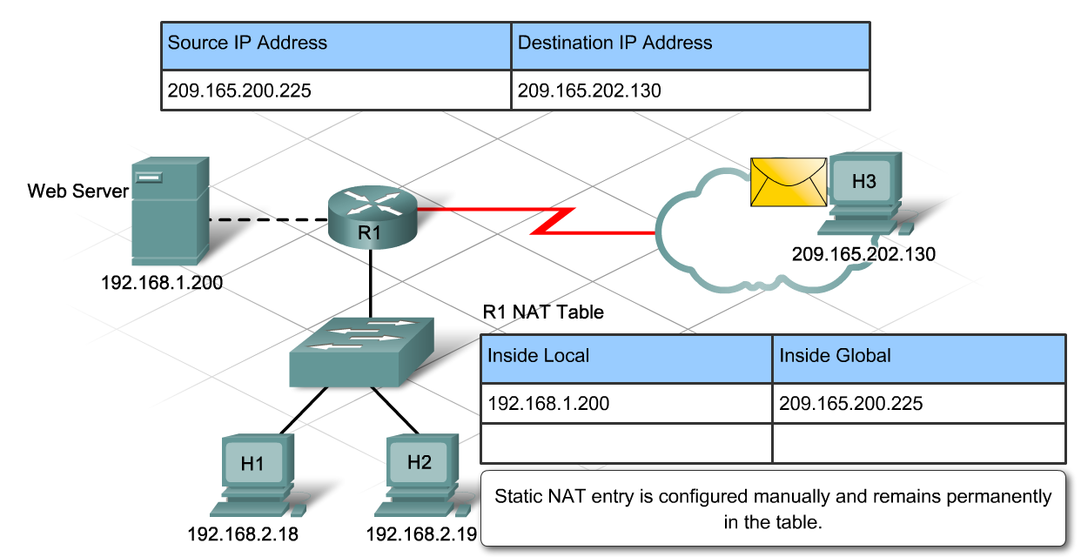
Cont…

Slide 46
Cont…
When you configuring NAT.
Identify device that need static Ip address.
Determine which internal hosts require translation.
Determine which interfaces source the internal traffic. These will become the inside interfaces.
Determine which interface sends traffic to the Internet. This will become the outside interface.
Determine the range of public addresses available.

Slide 47
Cont…
Dynamic NAT configuration use standard ACL.
The standard ACL is used to specify the range of hosts that require translation.
This is done in the form of a permit or deny statement.
Router(config)#ip nat pool name start-ip end-ip {netmask netmask | prefix-length prefix-length}
Defines a pool of global addresses to be allocated as needed
Router(config)#access-list access-list-number permit source [source-wildcard]
Defines a standard IP access list permitting those inside local addresses that are to be translated
Router(config)#ip nat inside source list access-list-number pool name
Establishes dynamic source translation, specifying the access list defined in the prior step

Slide 48
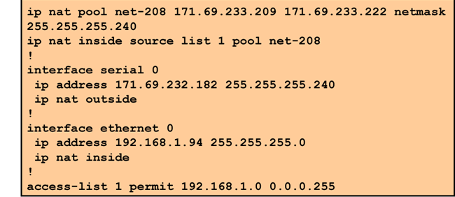
Cont…

Slide 49
PAT(port Address translation )
It is A dynamic NAT that use port, also referred to as NAT Overload.
PAT dynamically translates multiple inside local addresses to a single public address.
When a source host sends a message to a destination host, it uses an IP address and port number.
In PAT, the gateway router translates the local source address and port number combination to a single global IP address and a unique port number.

Slide 50
Cont…
Routing table contains a list of the internal IP address and port number combinations that are translated to the external address.
Each host translates into the same global IP & address, unique port number.
Since over 64,000 ports are available, a router is unlikely to run out of addresses.

Slide 51
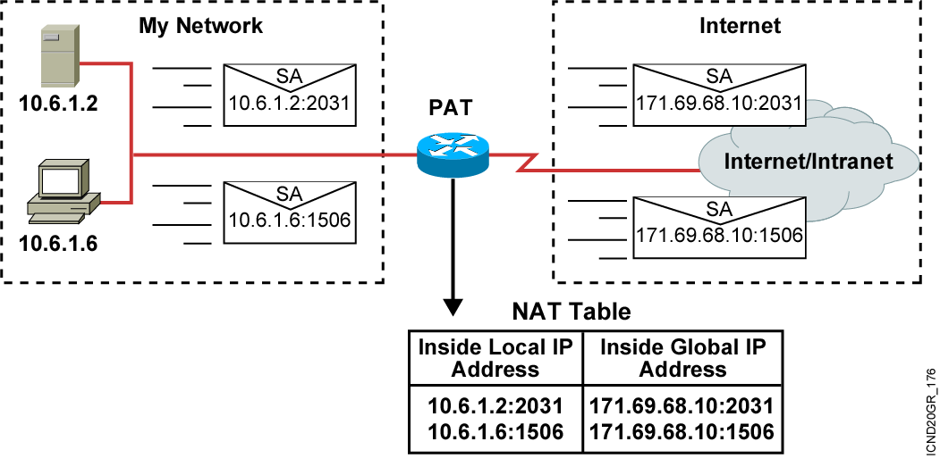
Cont…
Configuring PAT requires the same basic steps and commands as configuring NAT.
However, instead of translating to a pool of addresses, PAT translates to a single address.

Slide 52
Cont…
Router#clear ip nat translation
Clears all dynamic address translation entries
Router#show ip nat translations
Displays active translations
Router#show ip nat translation Pro Inside global Inside local Outside local Outside global --- 172.16.131.1 10.10.10.1 --- ---
Displays translation statistics
Router#showp nat statistics
Router#show ip nat statistics Total active translations: 1 (1 static, 0 dynamic; 0 extended) Outside interfaces: Ethernet0, Serial2.7 Inside interfaces: Ethernet1 Hits: 5 Misses: 0

Slide 53
EIGRP(Enhanced Interior Routing Protocol)
RIP a distance vector routing protocol have its own limitation:-
Hop count used by RIP is not accurate way to determine the best path.
RIP can reach maximum of 15 hops
RIP issues periodic updates of its routing table, which consume bandwidth.
Limitation of RIP lead development of EIGRP

Slide 54
Cont…
Although configuring EIGRP is relatively simple, contains d/f features.
All of these factors makes EIGRP an excellent choice for large, multi-protocol networks that employ primarily Cisco devices.
The two main goals of EIGRP are
1. Provide a loop-free routing environment
2. Rapid convergence.
The Diffusing Update Algorithm (DUAL) used by EIGRP guarantees loop-free operation while it calculates routes.
The metric used is a composite metric that primarily considers bandwidth and delay.
This metric is more accurate than hop count in determining the distance to a destination network.

Slide 55
Cont…
The administrative distance of EIGRP is 90, whereas the administrative distance of RIP is 120.
The lower number reflects the increased reliability of EIGRP and the increased accuracy of the metric.
Unlike other distance vector protocols, EIGRP does not send complete tables in its updates.
EIGRP multicasts partial updates about specific changes to only those routers that need the information, not to all routers in the area.
These are called bounded updates because they reflect specific parameters.

Slide 56
Cont…
EIGRP maintains multiple tables.
Neighbor Table
Topology table
Routing table
1. Neighbor Table
The neighbor table contain information about directly connected neighbor routers.
EIGRP records the address of a newly discovered neighbor and the interface that connects to it.

Slide 57
Cont…
2.Topology table
The topology table lists all routes learned from each EIGRP neighbor.
DUAL takes the information from the neighbor and topology tables and calculates the lowest cost routes to each network.

Slide 58
Cont…
3. Routing Table
Whereas the topology table contains information about many possible paths to a network destination, the routing table displays only the best paths called the successor routes.
EIGRP displays information about routes in two ways:
The routing table assign D routes learned through EIGRP
EIGRP learn other routes from other routing protocol, that assign DEX.

Slide 59
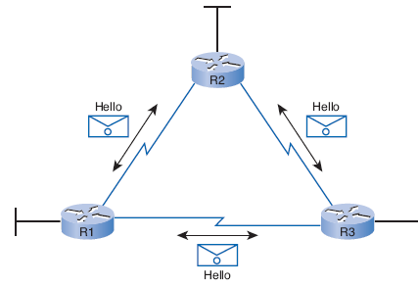
Cont...
Before EIGRP can exchange packets between routers, it must first discover its neighbors.
Hello packet
Used to discover neighbors.

Slide 60
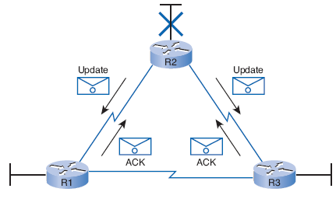
Cont…
Update packet
Used to propagate routing information
It send partial update
unless the network has not change EIGRP does not send update
X

Slide 61
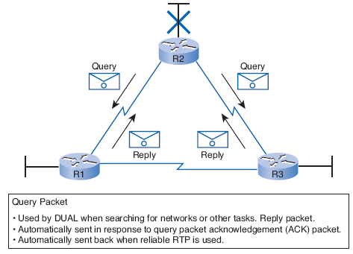
Cont…
Query & replay packet
Used by DUAL to search network
X

Slide 62
Cont…
When a neighbor adjacency is established, EIGRP uses various types of packets to exchange and update routing table information.
Neighbors learn about new routes, unreachable routes, and rediscovered routes through exchange of these packets:
Acknowledgement
Update
Query
Reply

Slide 63
Cont…
As a routing protocol, EIGRP operates independently of the Network Layer.
Cisco designed Reliable Transport Protocol (RTP) as a proprietary Layer 4 protocol.
RTP guarantees delivery and receipt of EIGRP packets for all Network Layer protocols.
Because large, complex networks may use a variety of Network Layer protocols, this protocol makes EIGRP flexible and scalable.

Slide 64
Cont…
EIGRP uses a composite metric value to determine the best path to a destination.
This metric is determined from the following values:
Bandwidth
Delay
Reliability
Load

Slide 65
Cont…
Bandwidth
The bandwidth metric is a static value and is displayed in kbps.
Most serial interfaces use the default bandwidth value of 1544 kbps.
Sometimes the bandwidth value may not reflect the actual physical bandwidth of the interface.

Slide 66
Cont…
Delay
The delay metric is a static value that is based on the type of exit interface.
The default value is 20,000 microseconds for Serial interfaces and 100 microseconds for Fast Ethernet interfaces.
Reliability
Reliability measures how often the link has experienced errors.
Unlike delay, reliability updates automatically, depending on the link conditions.
It has a value of between 0 and 255.
A reliability of 255/255 represents a 100 percent reliable link.

Slide 67
Cont…
Load
Load reflects the amount of traffic using the link.
A lower load value is more desirable than a higher value.
As an example, 1/255 would be a minimally loaded link, and 255/255 would be a link that is 100 percent utilized.

Slide 68
Cont…
The Hold time is the period that EIGRP waits to receive a hello packet.
The hold time is the length of time that a router treats a neighbor as reachable.
Generally, the hold time is three times the duration of the Hello interval(period of time in seconds that a router keeps hello packet from neighbor).
When the hold time expires and EIGRP declares the route as down, DUAL re-evaluates the topology and refreshes the routing table.

Slide 69
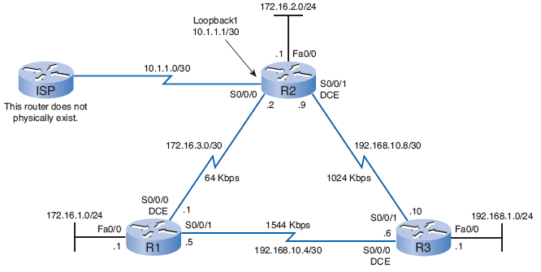
Cont…

Slide 70
Cont…
EIGRP Configuration
router eigrp 1
network 172.16.0.0
network 192.168.10.4
router eigrp 1
network 172.16.0.0
network 192.168.10.8 0.0.0.3
router eigrp 1
network 192.168.1.0
network 192.168.10.0

Slide 71
Cont…
R1# show ip route
Codes: C - connected, S - static, I - IGRP, R - RIP, M - mobile,
D - EIGRP, EX - EIGRP external, O - OSPF,
<Output omitted>
192.168.10.0/24 is variably subnetted, 3 subnets, 2 masks
D 192.168.10.0/24 is a summary, 00:03:50, Null0
C 192.168.10.4/30 is directly connected, Serial0/0/1
D 192.168.10.8/30 [90/2681856] via 192.168.10.6,00:02:43, S0/0/1
172.16.0.0/16 is variably subnetted, 4 subnets, 3 masks
D 172.16.0.0/16 is a summary, 00:10:52, Null0
C 172.16.1.0/24 is directly connected, FastEthernet0/0
D 172.16.2.0/24 [90/2172416] via 172.16.3.2, 00:10:47, S0/0/0
C 172.16.3.0/30 is directly connected, Serial0/0/0
D 192.168.1.0/24 [90/2172416] via 192.168.10.6, 00:02:31, S0/0/1

Slide 72


Slide 73

Enabling IGRP
© 2002, Cisco Systems, Inc. All rights reserved.
<number>
Notes:
Purpose: This chapter introduces the Cisco IOS™ CLI on the Catalyst® 1900 switch and router.
Timing: This chapter should take about 2 hours to present.
Note: The Catalyst 1900 switch only has a subset of the router Cisco IOS commands available.
Contents:
Introduction to Cisco IOS. Explain to the student what is IOS?
Cisco Device startup procedures in general.
IOS configuration source.
General introduction to the IOS CLI.
Cat 1900 switch startup procedures.
Intro to Cat 1900 CLI. This part covers the basic configuration on the switch, like setting the IP address and hostname. More details about the various Cat 1900 switch configuration commands are explained in Chapter 6 and 7.
Router startup procedures. More details on the router startup process is discussed in chapter 5.
Router IOS CLI.

Slide 74
Objectives
Upon completing this lesson, you will be able to:
Describe the features and operation of IGRP
Use Cisco IOS commands to configure dynamic routing using IGRP, given a functioning router
Use show and debug commands to identify anomalies in dynamic routing operation using IGRP, given an operational router
Notes:
Slide 1 of 2
Purpose: This slide states the chapter objectives.
Emphasize: Read or state each objective so that each student has a clear understanding of the chapter objectives.
Note: Catalyst switches have different CLIs. The Catalyst 2900xl and the Catalyst 1900 has a Cisco IOS CLI. The Cisco IOS CLI commands available on the 2900xl is different from the 1900. The Catalyst 5000 family has no Cisco IOS CLI, and use the set commands instead. This class only covers the configuration on the Catalyst 1900 switch.

Slide 75
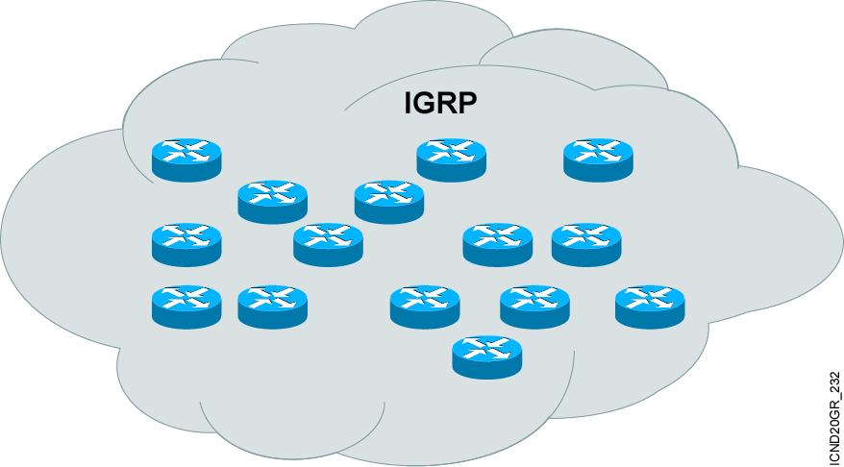
Introducing IGRP
More scalable than RIP
Sophisticated metric
Multiple-path support
Notes:
Purpose: The figure introduces the IGRP routing protocol. IGRP is a sophisticated distance vector routing protocol.
Emphasize: The Interior Gateway Routing Protocol (IGRP) is a dynamic distance-vector routing protocol designed by Cisco in the mid-1980s for routing in an autonomous system that contains large, arbitrarily complex networks with diverse bandwidth and delay characteristics. Historically, IGRP became one of the success factors for the early Cisco IOS software capabilities because of its superiority to RIP version 1.
The important IGRP characteristics are as follows:
More scalability than RIP
Fast response to network changes
Sophisticated metric
Multiple-path support

Slide 76
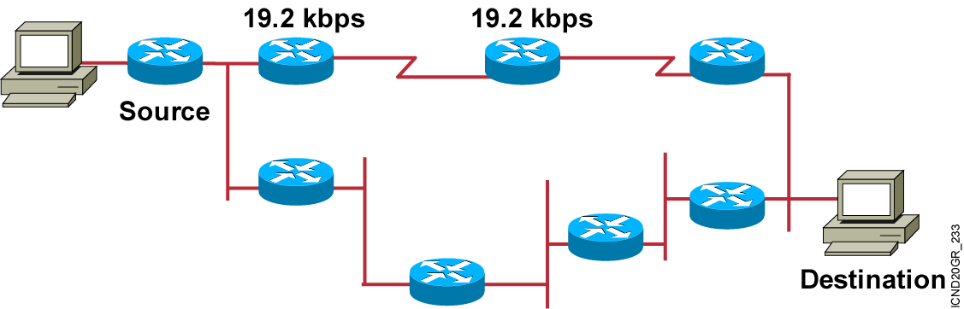
IGRP Composite Metric
Bandwidth
Delay
Reliability
Loading
MTU
Notes:
Purpose: This figure presents the IGRP metric with its five possible components.
Emphasize : Bandwidth and delay are the two metrics that are most commonly used. They also comprise the default metric.
Note: Changing IGRP metrics can have great impact on network performance.
Describe the IGRP 24-bit metric field, as follows:
Bandwidth—Minimum bandwidth on the route, in kilobits per second.
Delay—Route delay, in tens of microseconds.
Reliability—Likelihood of successful packet transmission, expressed as an integer from 0 to 255.
Loading—Effective bandwidth of path.
MTU—Minimum MTU in path, expressed in bytes.
The following equation calculates the metric. It is presented for instructors and is not required to be taught:
metric = [k1 x bandwidth + (k2 x bandwidth) / (256 - load) + k3 x delay]
If k5 does not equal 0, an additional operation is done:
metric = metric x (k5/(reliability + k4))
The default constant values are k1 = k3 = 1 and k2 = k4 = k5 = 0.
Again, if default values are set, metric = bandwidth + delay.
The constants (k1, k2, k3) can be changed using the metric weights command. Changes to the IGRP constant values should be made with great care.

Slide 77
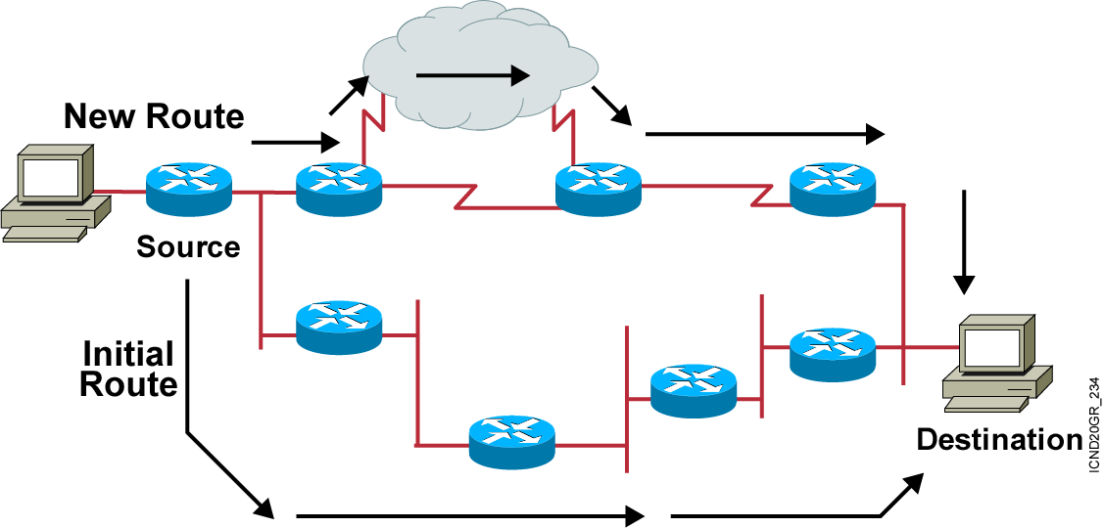
IGRP Unequal Multiple Paths
Maximum 6 paths (default = 4)
Within metric variance
Next-hop router closer to destination
Notes:
Purpose: The figure presents how IGRP load sharing improves throughput and increases reliability.
Emphasize: Only feasible paths can be used for IGRP load sharing.
Load-balancing methods vary according to the switching mode because the data structures for process switching, fast switching, and autonomous switching are all different. When process switching, the processor load-balances packet by packet. When fast, autonomous, or silicon switching, load balancing is done destination by destination.
By default, the amount of variance is set to one, which results in equal-cost load balancing.
You can use the default-metric command to change the default metric.
Transition: The following pages describe how to configure the IGRP routing protocol.

Slide 78
Configuring IGRP
Router(config)#router igrp autonomous-system
Defines IGRP as the IP routing protocol
Router(config-router)#network network-number
Selects participating attached networks
Notes:
Slide 1 of 2
Purpose: This figure explains how to use the router igrp and network commands to configure an IGRP process.
Emphasize: Note that the AS keyword is required for IGRP.
You can use multiple network commands to specify all networks that are to participate in the IGRP process. Only those networks specified will be published to other routers.

Slide 79
Configuring IGRP (cont.)
Router(config-router)#variance multiplier
Controls IGRP load balancing
Router(config-router)#traffic-share {balanced | min}
Controls how load-balanced traffic is distributed
Notes:
Slide 2 of 2
Purpose: This figure displays the commands to allow load sharing and load balancing in an IGRP environment.
Emphasize: Note the router configuration mode to the students.

Slide 80
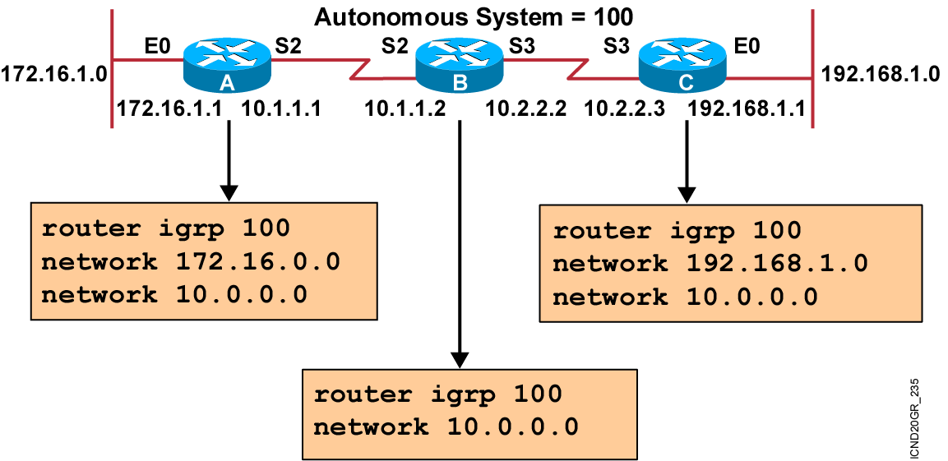
IGRP Configuration Example
Notes:
Purpose: The figure shows how the IGRP commands operate on the example network.
Emphasize: An administrator only specifies directly connected networks that should be published to other routers.
Without the network command, nothing is advertised. With a network command, the router will advertise every subnet within the Class A, B, or C network specified in the configuration.

Slide 81
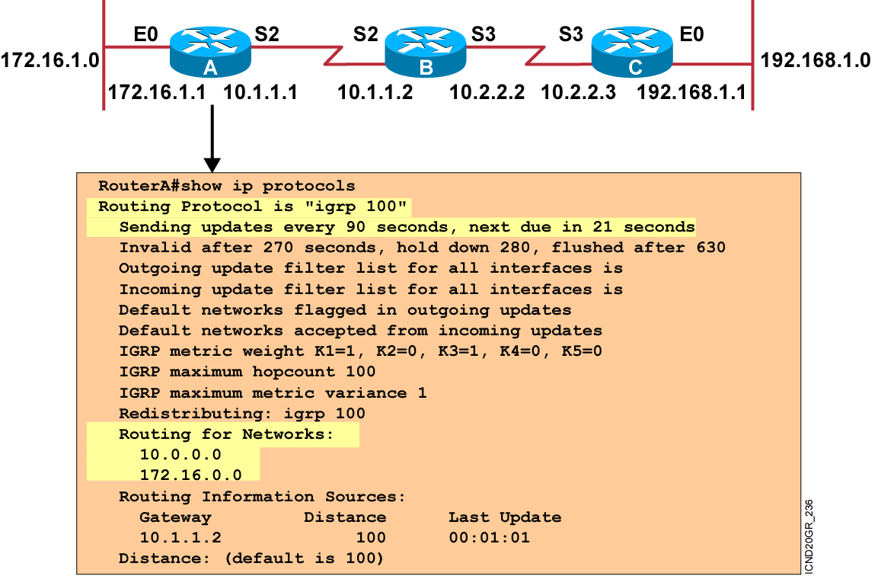
Verifying the IGRP Configuration
Notes:
Purpose: This figure shows how the show ip protocol command is used to monitor IGRP operation.
Emphasize: The command displays the routing protocols that are active on the router for IP. It also gives network and timer information. In this example, IGRP is displayed.
Point out the timing information.
Point out the list of networks for which the router is injecting routes.
Point out the administrative distance metric.

Slide 82
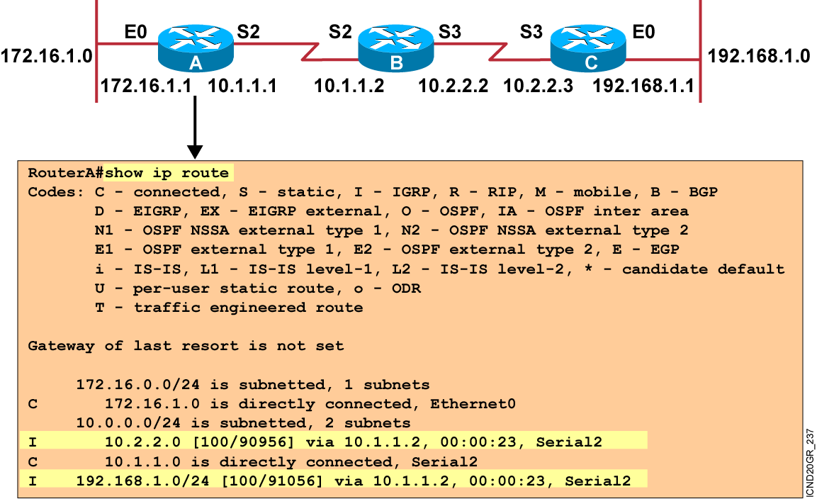
Displaying the IP Routing Table
Notes:
Purpose: This figure displays the show ip route command, which displays the contents of the router’s IP routing table.
Emphasize: This is the same command presented earlier in the chapter. Discuss the IP routing table in detail. The [100/90956] represent the administrative distance and metric, respectively.
Discuss the following fields:
I—Refers to routes learned from IGRP.
via—Refers to the router that informed us about this route.
00:00:23 timer value—IGRP updates are every 90 seconds. Ask, “How long until the next update?”
The interfaces used for the best path.

Slide 83
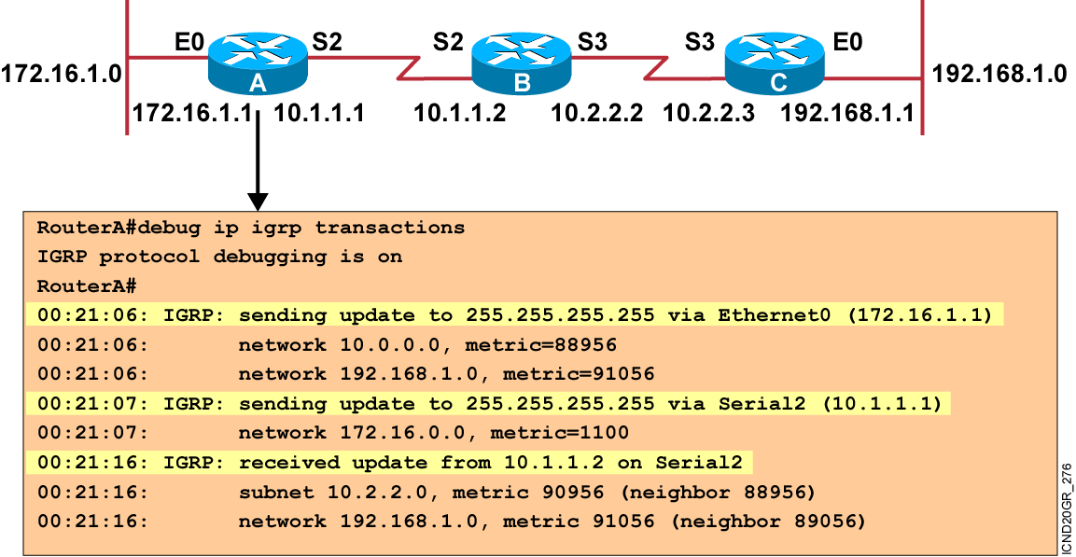
debug ip igrp transaction Command
Notes:
Purpose: This figure presents the debug ip igrp transaction command.
Emphasize: The debug ip igrp transaction command displays all updates that are sent from and received by your router.

Slide 84
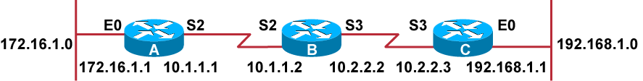
debug ip igrp events Command
RouterA#debug ip igrp events
IGRP event debugging is on
RouterA#
00:23:44: IGRP: sending update to 255.255.255.255 via Ethernet0 (172.16.1.1)
00:23:44: IGRP: Update contains 0 interior, 2 system, and 0 exterior routes.
00:23:44: IGRP: Total routes in update: 2
00:23:44: IGRP: sending update to 255.255.255.255 via Serial2 (10.1.1.1)
00:23:45: IGRP: Update contains 0 interior, 1 system, and 0 exterior routes.
00:23:45: IGRP: Total routes in update: 1
00:23:48: IGRP: received update from 10.1.1.2 on Serial2
00:23:48: IGRP: Update contains 1 interior, 1 system, and 0 exterior routes.
00:23:48: IGRP: Total routes in update: 2
Notes:
Purpose: This figure presents the debug ip igrp events command.
Emphasize: When there are many networks in your routing table, displaying every update for every route can flood the console and make the router unusable.
The debug ip igrp events command displays a summary of IGRP routing messages. This command indicates the source and destination of each update, as well as the number of routes in each update. Messages are not generated for each route.

Slide 85
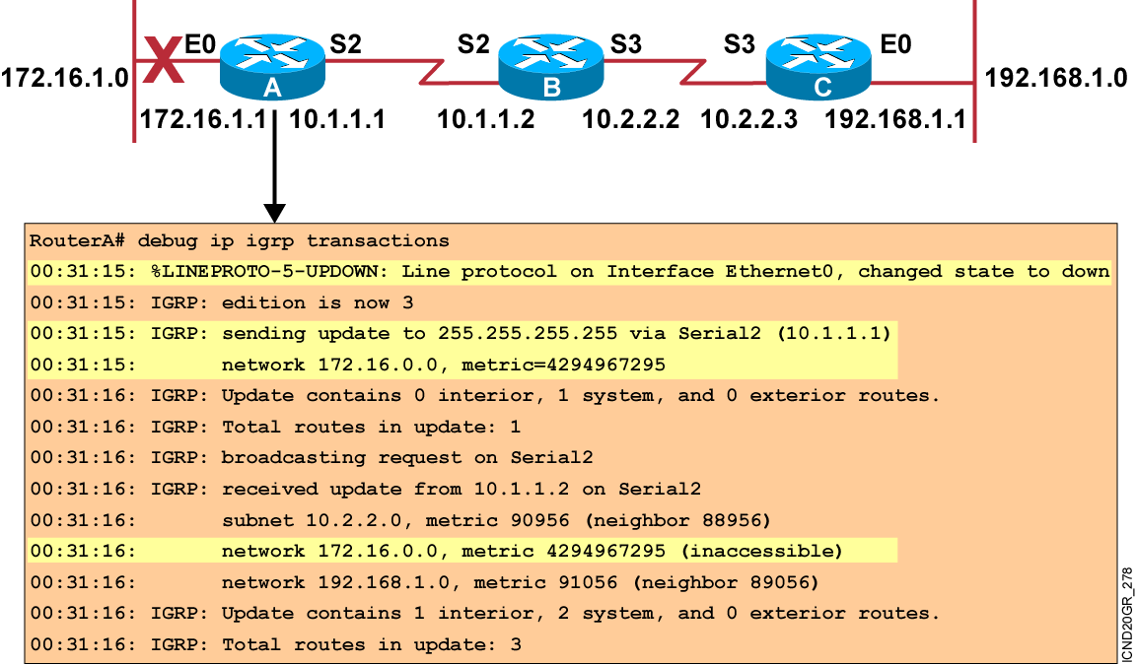
Updating Routing Information Example
Notes:
Slide 1 of 4
Purpose: The next few pages illustrate IGRP update operation when network information changes.
Emphasize: Network 172.16.0.0 fails. Router A sends a triggered update to router B.

Slide 86
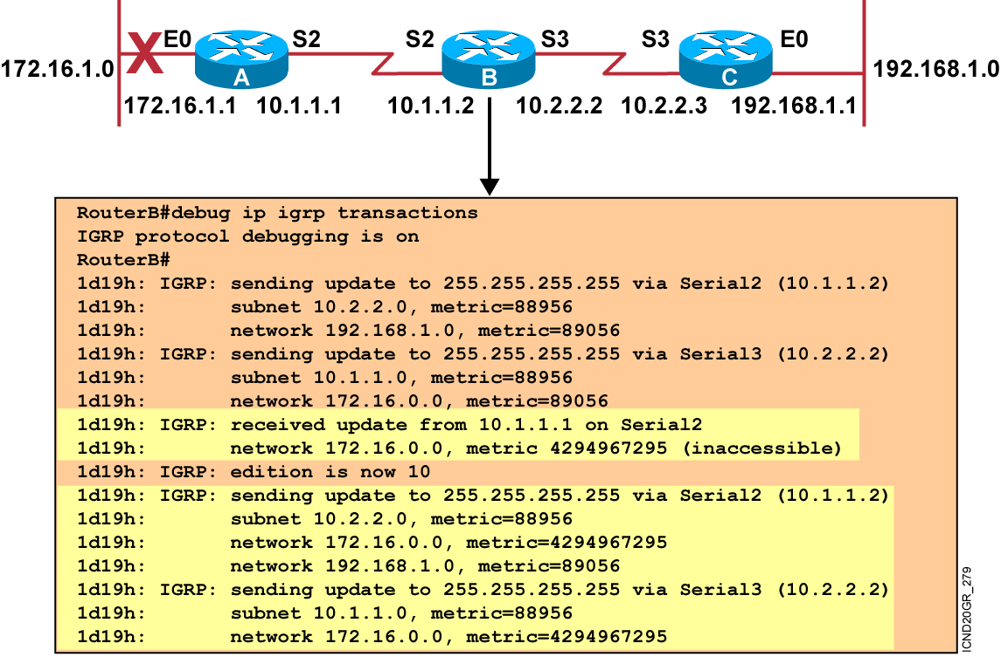
Updating Routing Information Example (Cont.)
Notes:
Slide 2 of 4
Purpose: This figure continues to illustrate IGRP update operation when network information changes.
Emphasize: Router B receives the triggered update from router A, sends a poison reverse to router A, and sends a triggered update to router C.

Slide 87
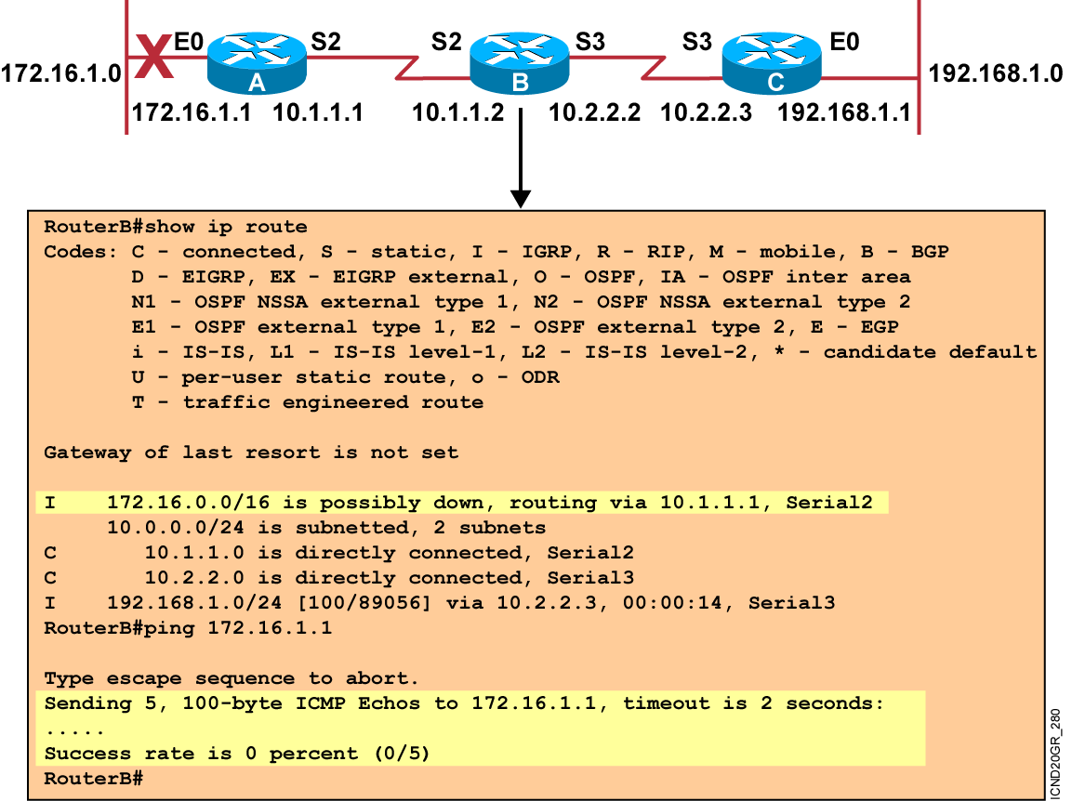
Updating Routing Information Example (Cont.)
Notes:
Slide 3 of 4
Purpose: This figure continues to illustrate IGRP update operation when network information changes.
Emphasize: Router B places route to network 172.16.0.0 in hold-down state. The route is marked as “possibly down” while in holddown. Router B will still attempt to forward packets destined to 172.16.0.0.

Slide 88
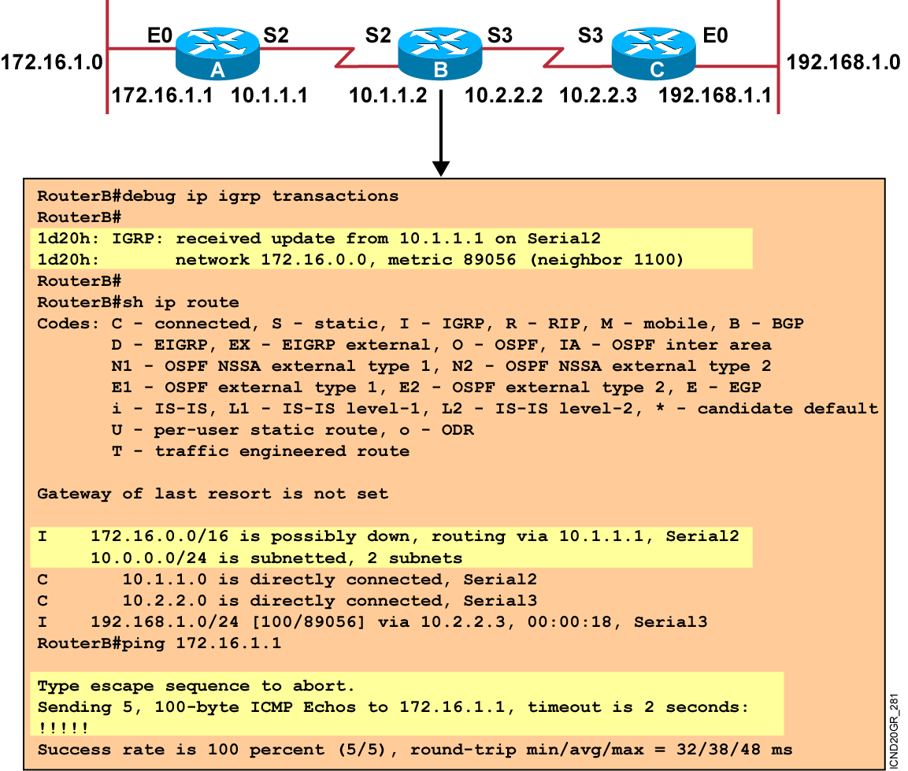
Updating Routing Information Example (Cont.)
Notes:
Slide 4 of 4
Purpose: This figure continues to illustrate IGRP update operation when network information changes.
Emphasize: If the link comes back up, router A will send another triggered update to router B. Router B will not update its routing table until the hold-down timer expires.

Slide 89
Summary
IGRP has several key features such as increased scalability, a sophisticated metric, and multiple paths.
IGRP uses a composite routing metric that can include bandwidth, delay, reliability, loading, and MTU value.
The IGRP composite routing metric supports multiple paths between source and destination.
Use the router igrp and network commands to create an IGRP routing process. Use the variance and traffic-share commands to configure IGRP load balancing.
Use the show ip protocols and show ip route commands to display information about your IGRP configuration.
Use the debug ip igrp transaction command to display transaction information on IGRP routing transactions and the debug ip igrp events command to display a summary of the IGRP routing information.
Notes:
Purpose: This slide discuss the initial configurations on the routers and switches.
Note: There is no setup mode on the Catalyst 1900 switch.

